Slide 1
Time Series Regression in Practice
Yvonne Ho
Frank Sun
Jiayi Xiao

Slide 2
Introduction
Data Source: New York Stock Exchange with 500 companies (Kaggle)
Apple stock (AAPL): 1762 days
Three classical regression models used (Linear regression, ARIMA, LSTM) to do the prediction (close price).

Slide 3
Data Exploration

Slide 4
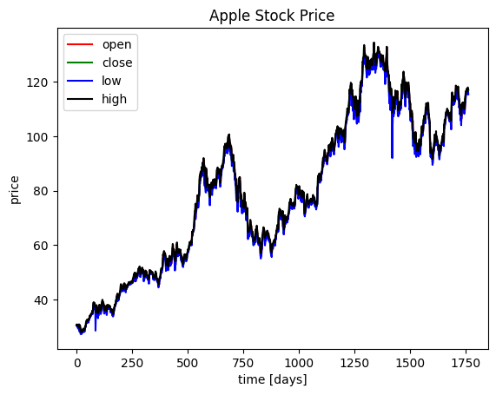
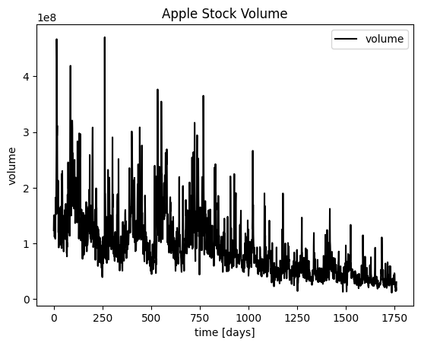
Data Description
Open & Close: opening and closing prices of the stock per day (when the markets open and then close).
High & Low: the highest/lowest price of the stock during that day.
Volume: number of stocks traded that day.

Slide 5
ARMA Modeling

Slide 6
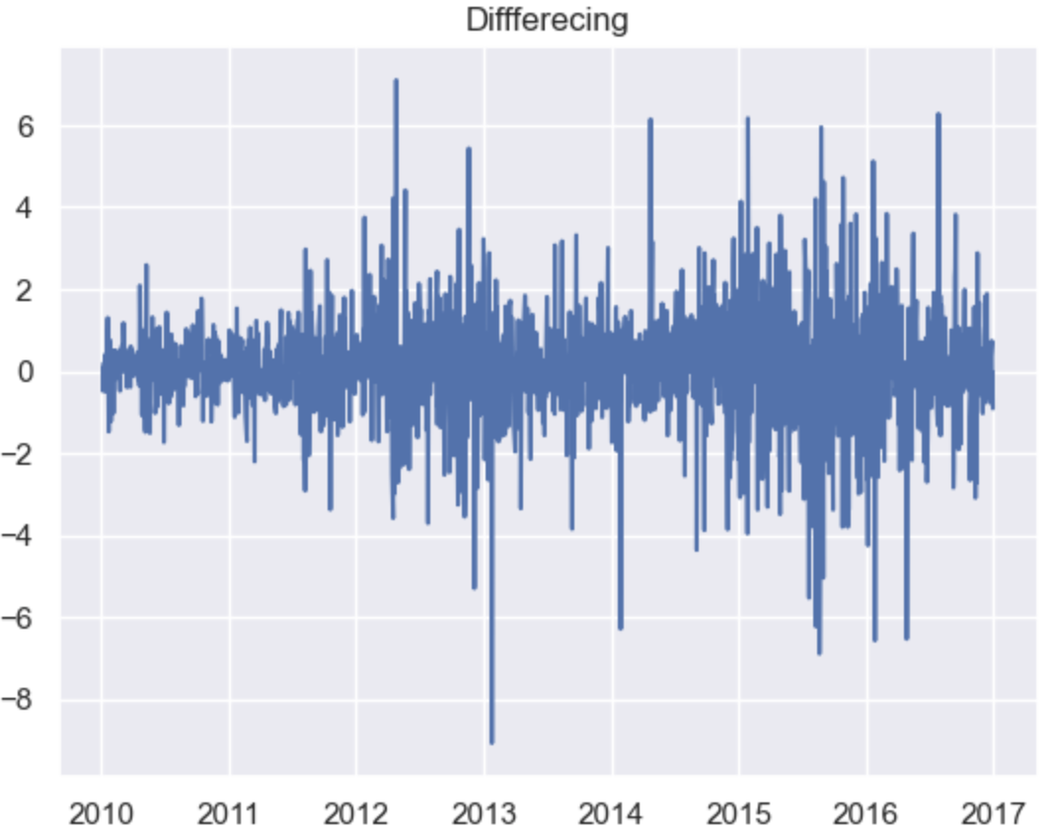
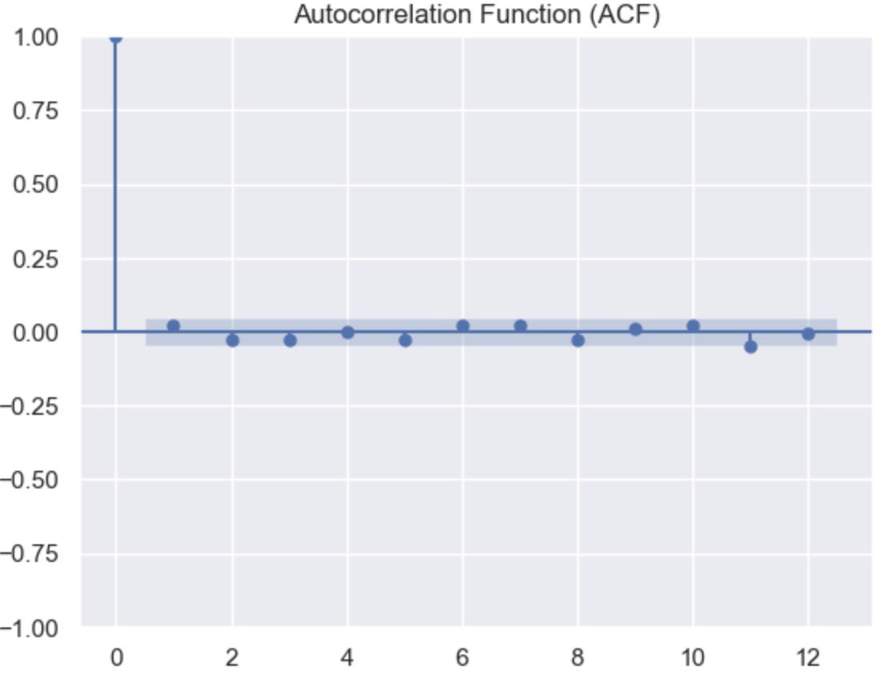
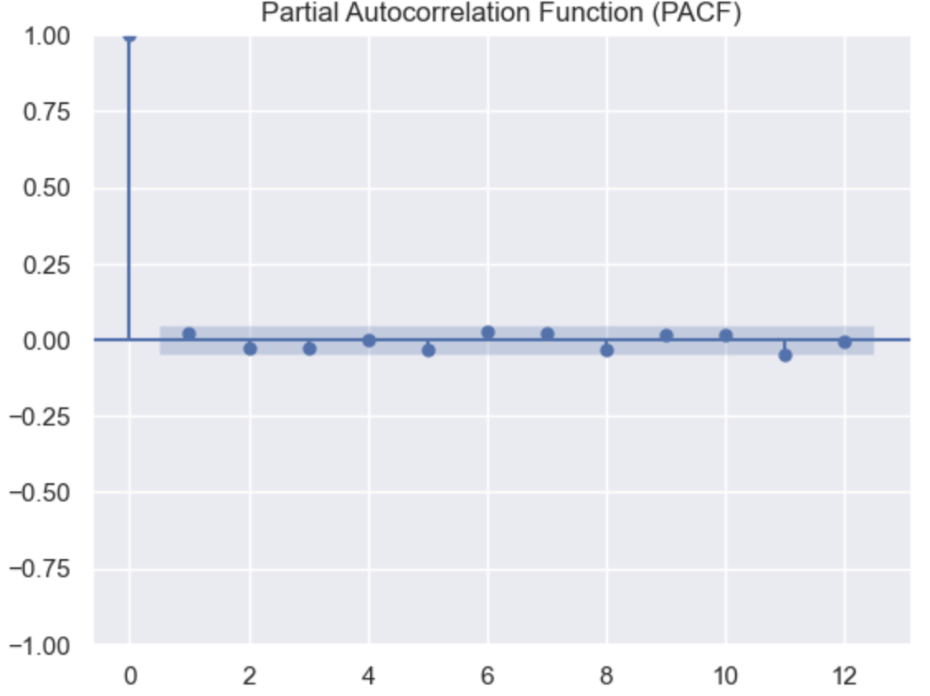
Model Selection
Assumptions Check: Stationary and Trend Stationary by ADF and KPSS tests
Transformation Attempts: Detrending, Differencing, and BoxCox Transformation
ARIMA(0,1,0)

Slide 7
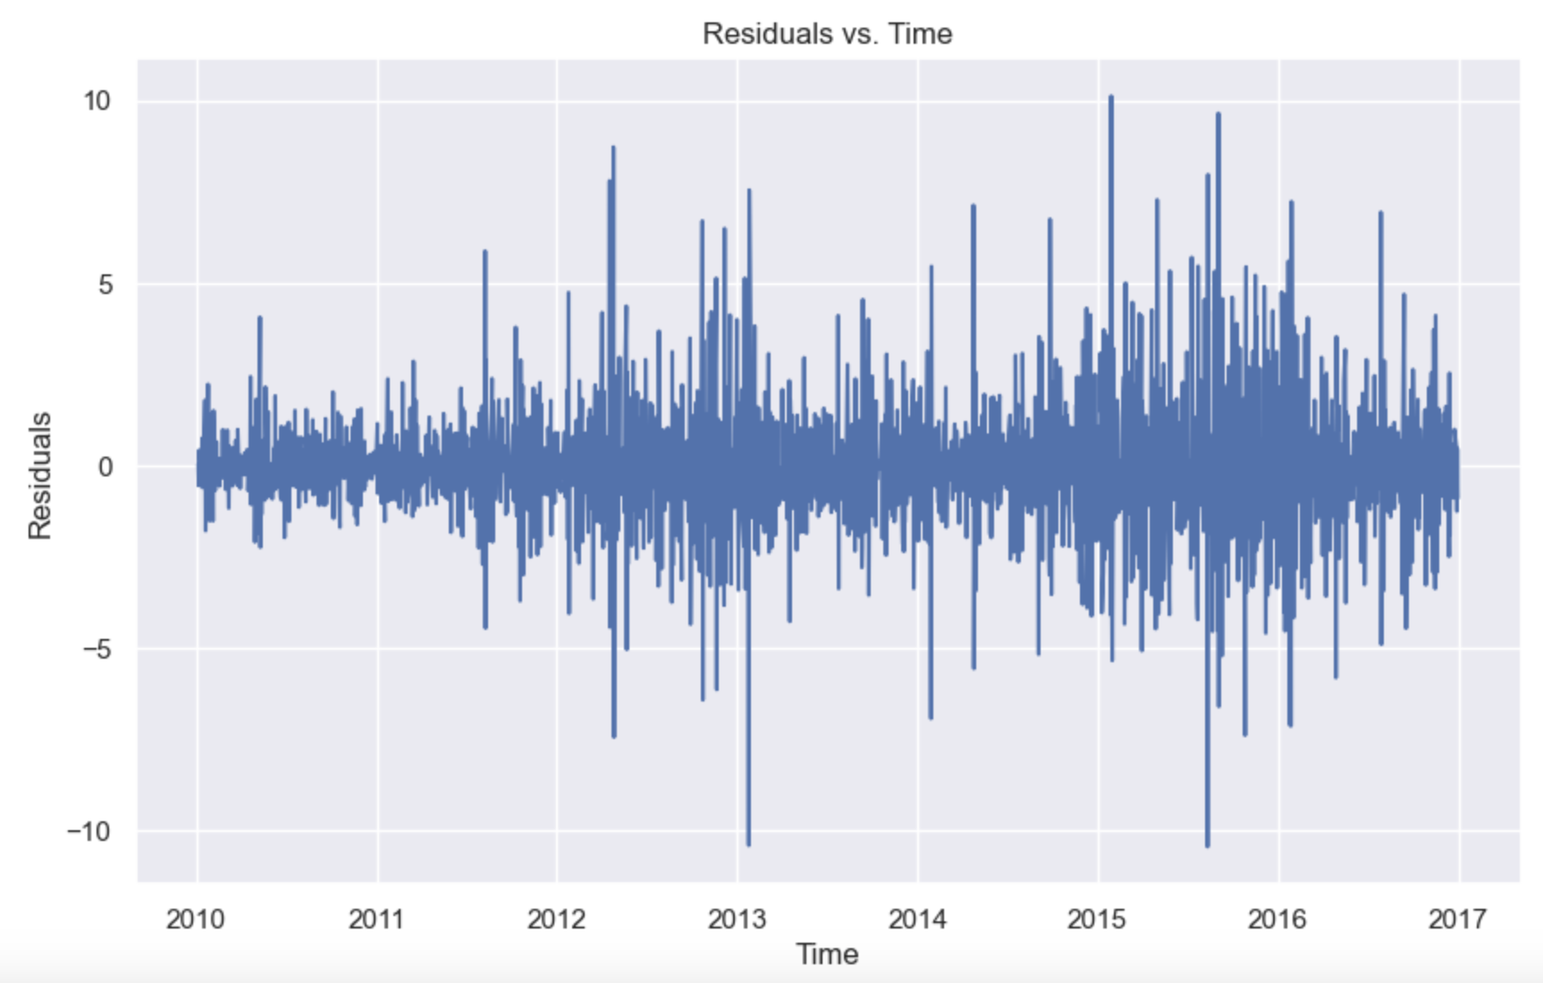
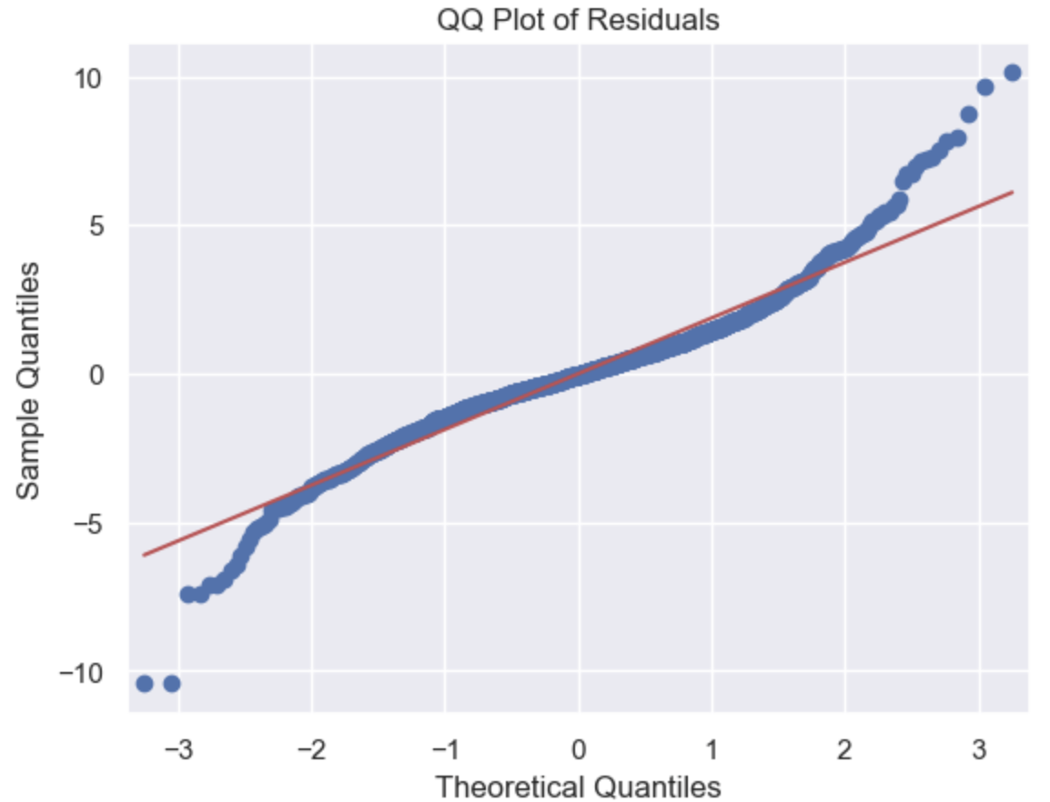
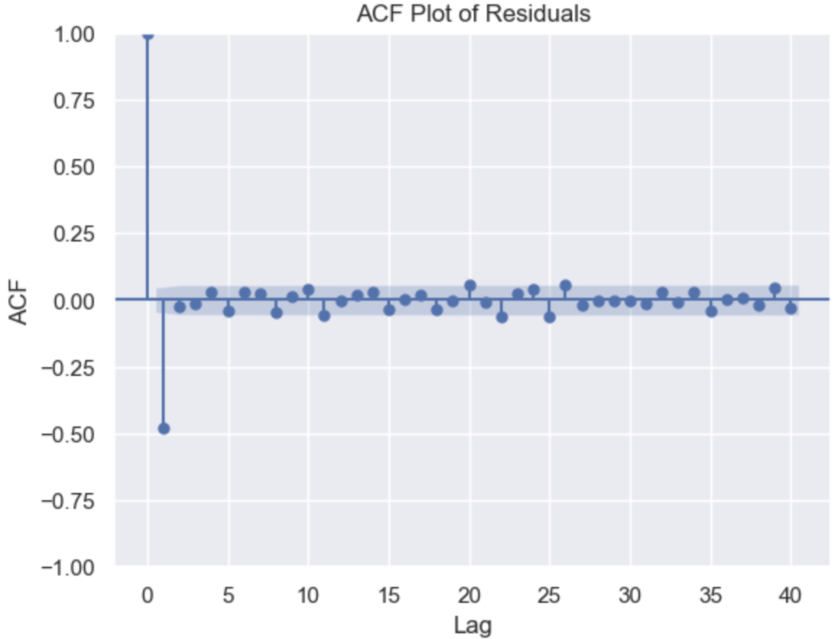
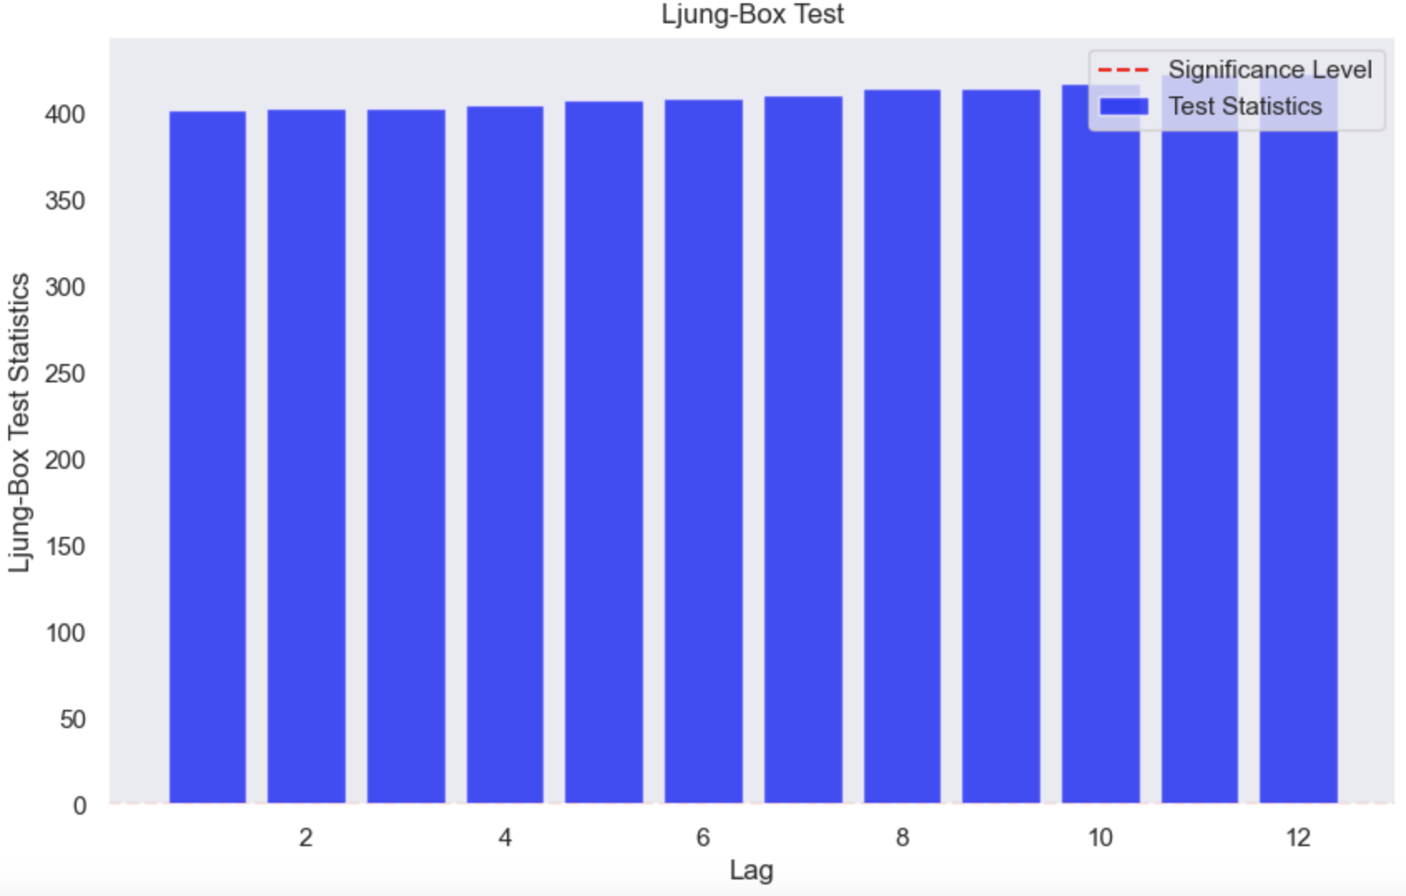
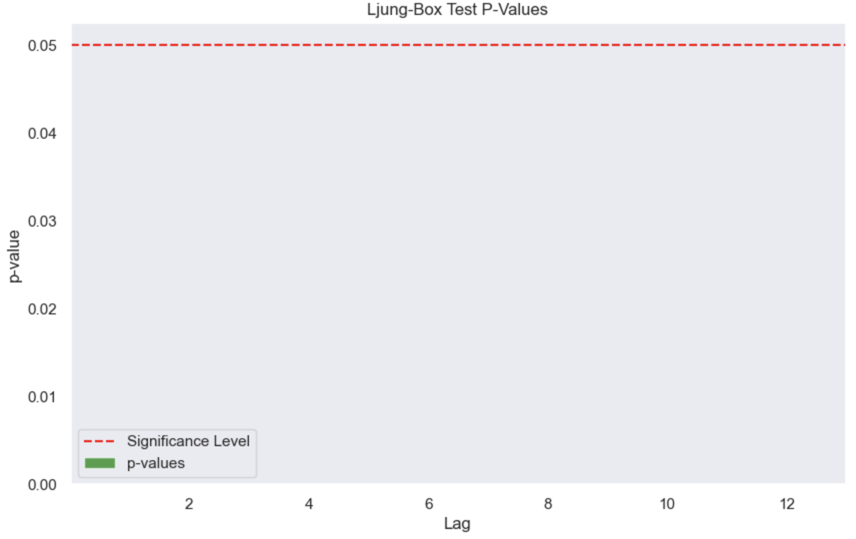
Residual Diagnosis

Slide 8
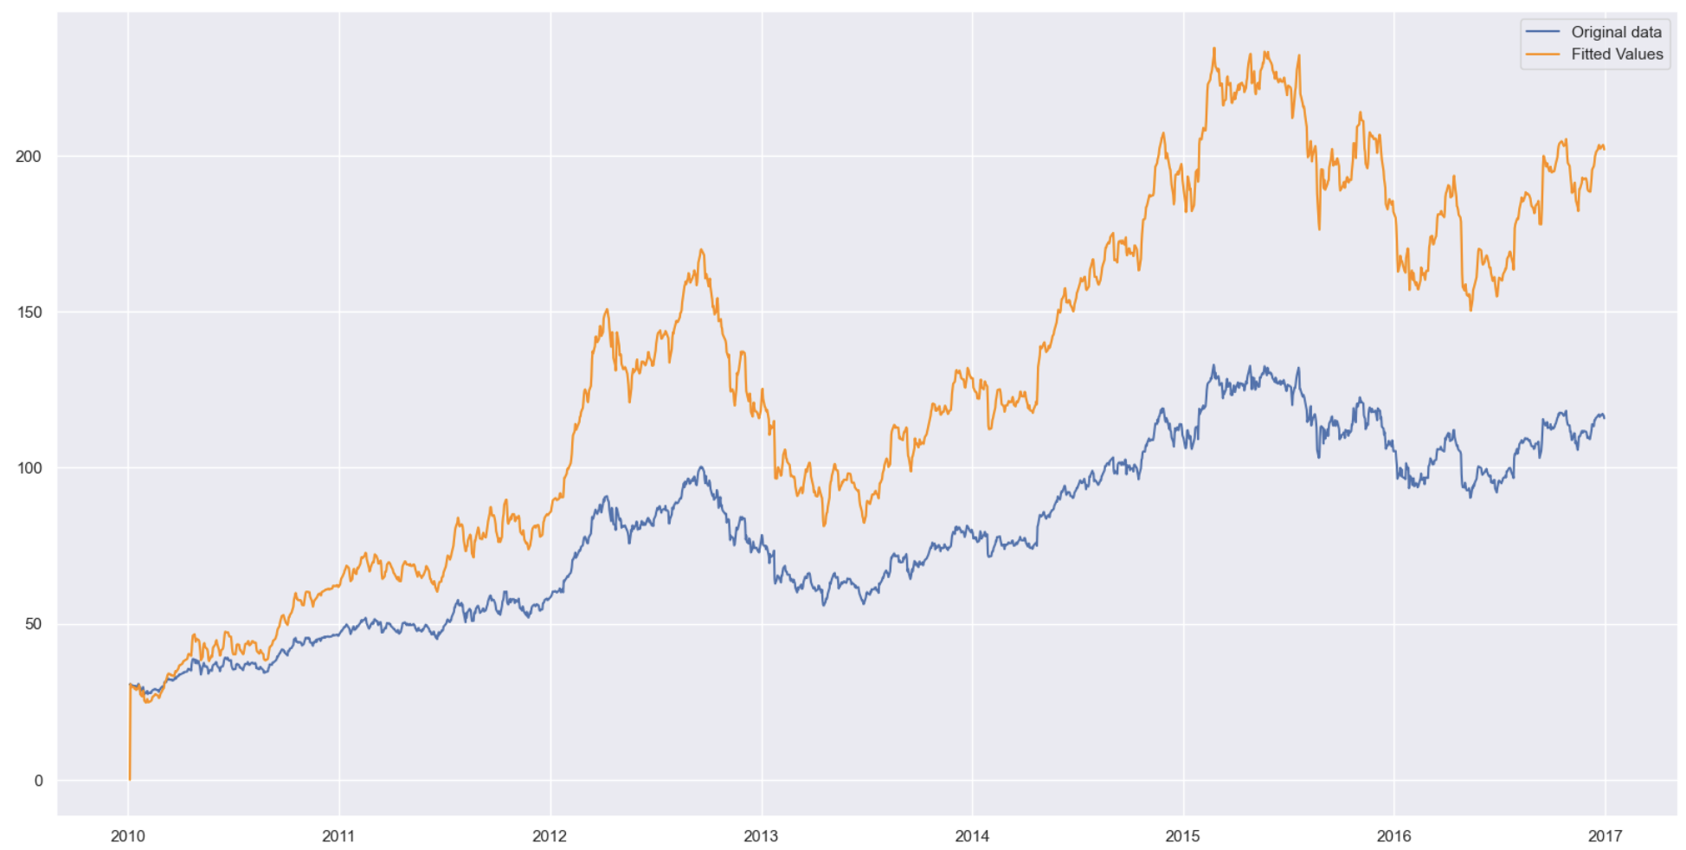
Prediction Result

Slide 9
Linear Regression

Slide 10
Applicability
Core Principle:
Establishes a linear relationship between variables.
Dependent variable: Future stock price.
Independent variable: Present price (or other predictors).
Simplicity & Efficiency:
Straightforward
Utilizes the least squares method for best fit.
Faster model training and prediction due to simplicity.
Benefits:
Provides clear insights with interpretable results.
Acts as a foundation for financial modeling.
Notes:
Before diving in, whenever we are trying to come up with a model for some data, we have to talk to its applicability. At its core, linear regression seeks to establish a linear relationship between a response variable and predictors variable. in the context of stock prediction, stock prices can exhibit non-linear trends over long periods, but they often move in relatively linear patterns over short periods. So in this case, the response variable is the future price, and the predictor variable can be present price. Another reason that we might choose linear regression is for its simplicity, it is very straightforward, replying on the least squared method to find the best line of fit. And this simplicity might translate to faster model training and prediction.

Slide 11
Limitation with Time Series
Linearity Assumption:
time series data often exhibits nonlinear trends and seasonality.
Stationarity:
Linear regression requires data to have a constant mean and variance. Time series data, especially stock prices, can be non-stationary.
External Shocks:
Sudden and unpredictable events can drastically affect time series data. Linear regression might not capture these shocks well.
Lag Variables
Notes:
Now, while we've discussed the strengths of linear regression, it's essential to balance our understanding by acknowledging its limitations, especially when applied to time series data.
Linearity Assumption: Time series data, with its ups, downs, and seasonal fluctuations, often defies simple linear trends. We can't always draw a straight line through such dynamic data.
Another challenge – linear regression assumes that our data has a steady mean and variance. But, as many of us have learned in this class, time series data, particularly stock prices, often waver and shift, making them non-stationary.
In addition to all these, in real life, The world is full of surprises, and the stock market is no exception. Events like financial crises or global pandemics can send shockwaves through the market. Linear regression might not always be agile enough to account for these sudden shifts.
So, How can we navigate around these limitations? There is looking at the trend, differencing, moving average, lasso, ridge. Today we are going to talk about introducing lag variables

Slide 12
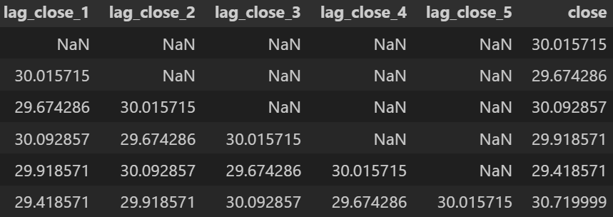
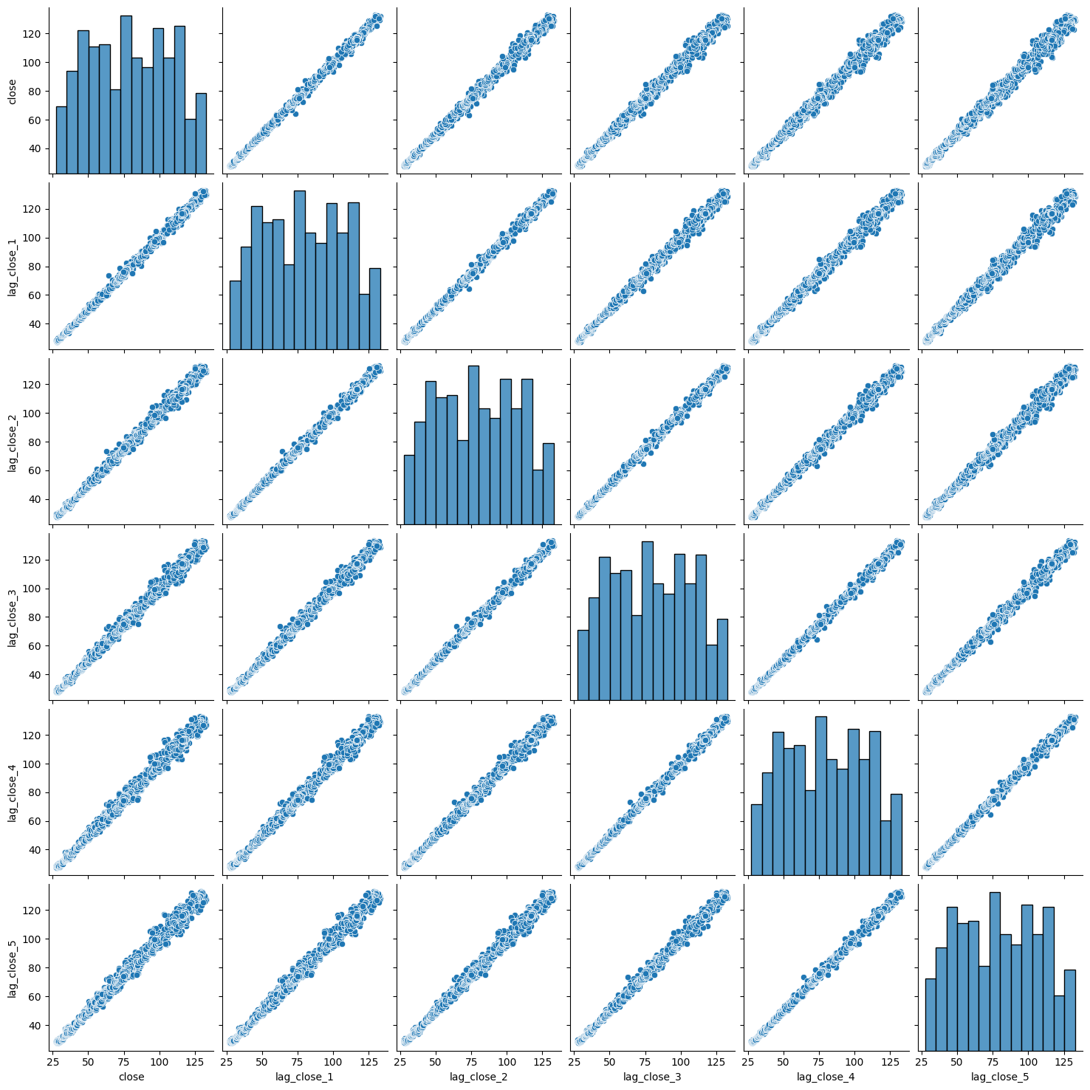
How lag fixes the problem?
Testing error without lag features : 0.470
Testing error with lag features: 0.367
Notes:
Think of lag variables as a window to the past. By incorporating past observations into our model, we're equipping it with a memory.
We can see from the lag plot that close price of Apple stock are correlated with closing price from the previous day. They are all have almost linear relationship with each other. So the lag feature will be useful for linear model.
This 'memory' helps in several ways:
Temporal Dependencies: Stock prices today might be influenced by their values from a few days or even months ago (in this case from the last 5 days). Lags allow us to capture these dependencies, giving our model a more informed basis for predictions.
Addressing Non-linearity: While stocks might exhibit short-term linear trends, they often unfurl non-linear behaviors over extended periods. Lags capture these short-term fluctuations, and when synthesized, they enable the model to navigate nonlinearity.
Reacting to Market Shocks: lag features enable us to remain adaptive to these abrupt changes

Slide 13
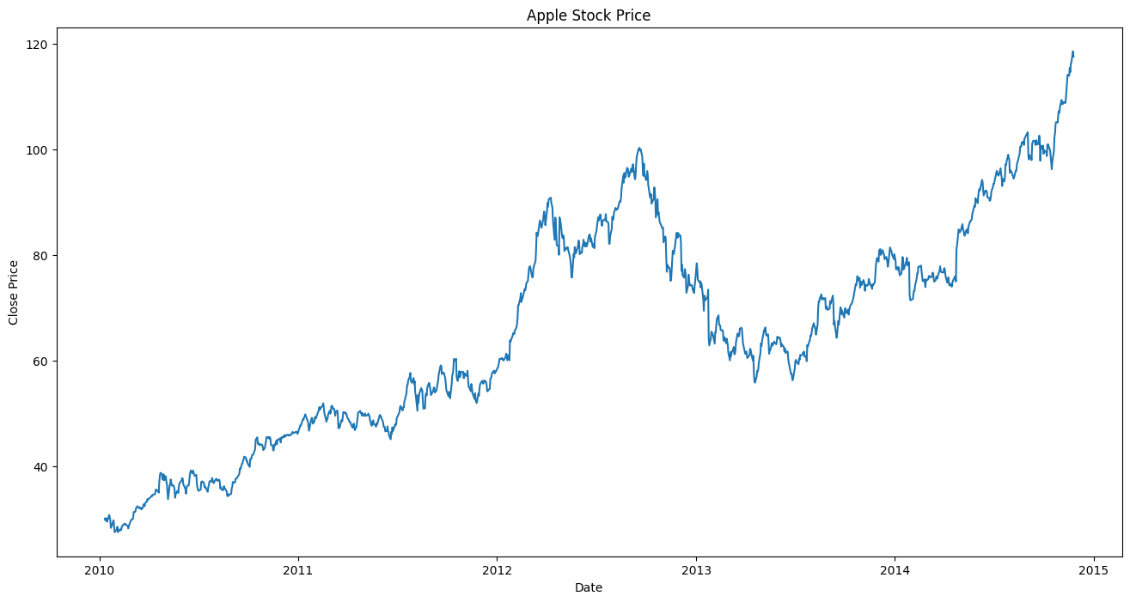
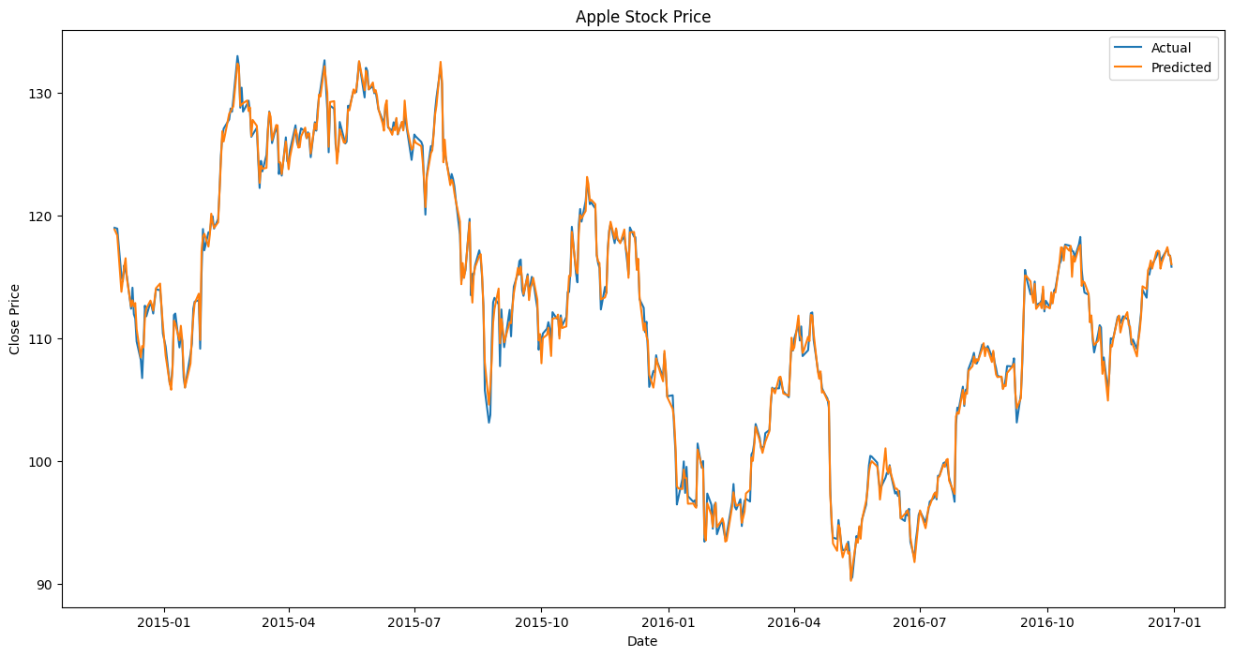
Prediction Result
Notes:
Marginal Improvement: While the improvement is marginal, it indicates that the lag features did contribute some useful information that helped reduce prediction error, even if only slightly
Complexity vs. Performance Trade-off: The addition of lagged features increases the complexity of the model. In this case, the complexity added by the lagged features results in only a small gain in predictive accuracy. It's important to weigh the benefits of this minor improvement against the added complexity, especially when considering interpretability, training time, and potential overfitting.
So in real life it really just depends.

Slide 14
Long Short-term Memory

Slide 15
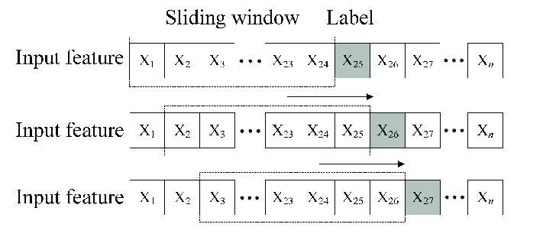
Windowed dataset
Used sliding window to create windowed dataset
Window size = 20 (commonly 20 trading days in a month)
70% training, 30% testing
Notes:
Before we train the model, we first created a windowed dataset by a using a sliding window. It is similar to what was covered in the class. Here we set the window size to be 20 time steps, which means we will use 20 data points to predict the next data point. After we predict one data point, we are going to slide the window one data point ahead and take the next 20 data points as the second window, and do the prediction, and so on.
By applying the sliding window on our dataset, it provide a fixed input size for LSTM networks, and it also ensures that the sequence order of data is preserved.
Then we split the dataset, 70% for training, 30% for testing.

Slide 16
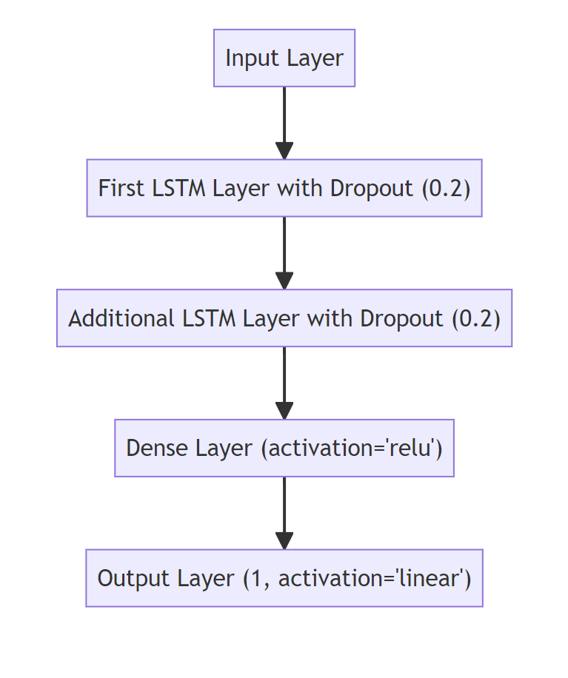
LSTM Model
LSTM: Updated version of RNN for sequential data analysis (capable of capturing long-term dependencies and complex patterns)
Independent variables: 4 features (open, low, high, volume)
Dependent variable (predictor): apple stock closing price
Input Layer
Hidden Layers (2 LSTM layers with drop out layers)
Dense layers
Output layer
Notes:
After we get the right dataset for LSTM, We are going to build our model.
LSTM is…
We use 4 features to predict the stock closing price.
Input our training data
Then we have two hidden layers with dropout.
Drop out: regularization technique to prevent overfitting. We randomly selects a subset of neurons and sets their outputs to zero, which means they will not be passed forward.
We have Dense layer to transform the features learned from the LSTM layers for regression tasks.
Finally we get prediction from output layer.

Slide 17
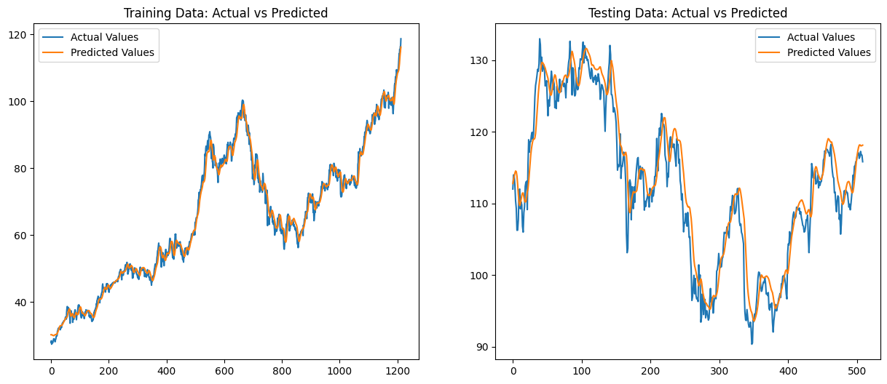
Prediction Result
Root mean square error (RMSE) for training data: 2.1259
Root mean square error (RMSE) for testing data: 2.7181
Notes:
After we trained our model and fit the data.
Here we can find there is a perfect fitting on the training data, but for the test data, it looks like there is right shift for the predicted values.
There might be multiple reasons for this issue.
If we increase the test size, we can get a more accurate fitting. So maybe more testing data can give the model more context info, help it better understand the underlying patterns of data, thus reducing the misalignment for the predicted values.
Besides increasing the the data size, we can also change the window size to see, if the window size is too big to cause the overfitting on training set, or it is too small to identify potential patterns and make accurate predictions.
If we just look at the RMSE for the testing and training set. LSTM can actually did a good prediction.

Slide 18
Conclusion

Slide 19
Model Comparison
 | Linear Regression | ARIMA | LSTM
Performance Evaluation (MSE) | Training Error: 0.1402 Testing Error:0.3709 | RMSE: 56.4175 | Train Error: 2.1259 Test Error: 2.7181
Interpretability | High, simple | Essential for discovered associations | Less interpretable due to its complex architecture
Training Time | <1s | 1s | 83.0468 s
Flexibility | Good | Depends on complexity of the problem | Very flexible
Notes:
Linea interpretability:
Coefficients of each predictor provide a clear understanding of the relationship between predictors and the response variable.
Err looks good.It is neural network, it has lots of layers and neurons. So it is less interpretable.
Computation time: highest
One thing to note here is that LSTM is designed to capture long-term dependencies in sequential data. So It is very useful if we want to do some long-term prediction. It is very flexible Lstm can handle different time dependencies (short-term or long term relationships). it has many hyperparameters that we can tune.

Slide 20
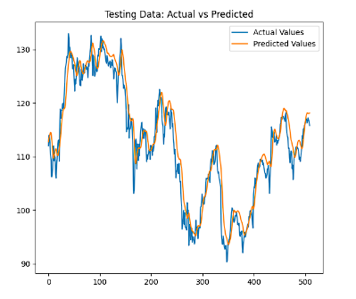
Model Selection in Time Series Practice
Notes:
When it comes to actually building a model in practice: we have to a lot of things to consider
Simplicity & Complexity & Interpretability:
Simpler models, like linear regression, can often provide comparable or even superior performance to more complex models. Their inherent simplicity offers high interpretability, making it easier to explain and understand the relationships between predictors and the response.
: LSTM networks can remember and learn from long-term dependencies in time series data, making them adept at capturing complex patterns.
Data & Feature Engineering:
The nature of the dataset, its size, and the quality of feature engineering all are signiifacnt in model performance. Thoughtful feature engineering can enhance even simple models' performance, as seen with the introduction of lag features.
In practice, investors will usually use a combination of time series analysis and cross-sectional analysis before making a decision

Slide 21
References
https://www.kaggle.com/datasets/dgawlik/nyse
https://ieeexplore.ieee.org/document/9366425
Github Link:
https://github.com/Jiayi1827/STAT430_Demo

Slide 22
Thank you!

